Slide 1
CS6451: Advanced Software Design
Lecture A: Introduction, Good Software, and Recap on the OO Paradigm
J.J. Collins
Dept. of CSIS
University of Limerick

Slide 2
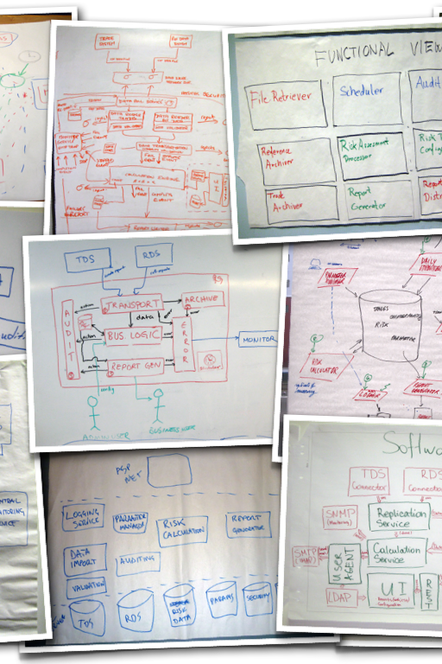
Objectives
Outline assessment instruments
Walkthrough syllabus and recommended texts
Discuss
  Characteristics of good software,
  SLC, and
  OO Paradigm
721721
© www.infoq.com

Slide 3
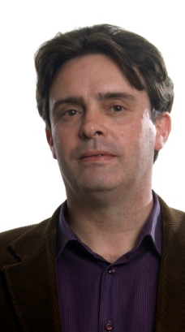
1. Lecturers
J.J. Collins
j.j.Collins@ul.ie
LM121 Computer Science Course Director
Course Director new 4-year integrated BSc/MSc Immersive Software Engineering
Teaching AY 26/27: Software Design, Deep Learning, Deep RL, Neural Computing
Research:
  Evolutionary Algorithmss for automatic parallelisation of sequential code,
  Previous work in Reinforcement Learning, Robotics, Computer Vision, Business Process Orchestration and Service Level Agreements (SLAs)
CS6451

Slide 4

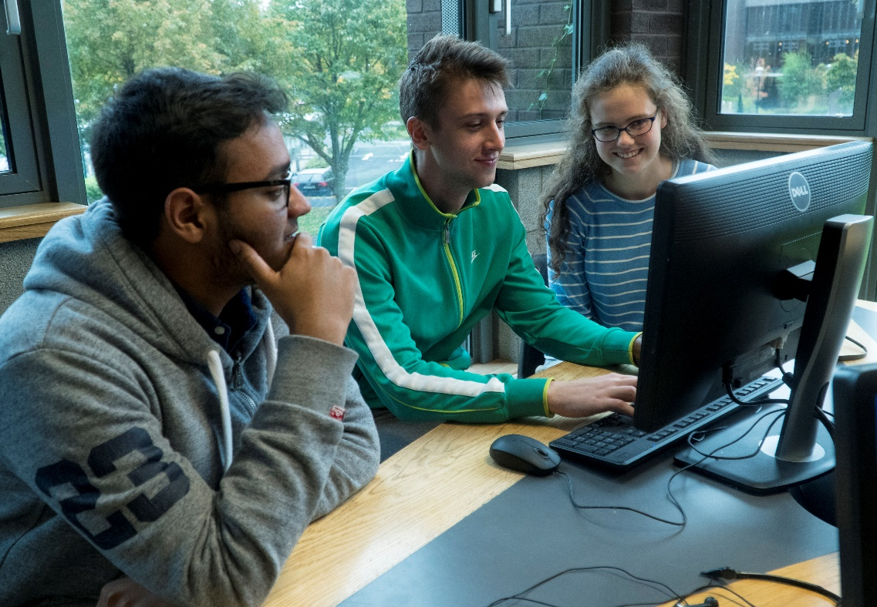
CONTEXT for the Module
Enterprise Development
Applications with significant Business Logic & 000s LOCs
Globally distributed development teams

Slide 5
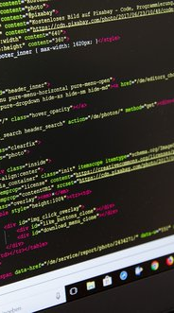
Programming is Dead
Because LLMs can now generate 100% of the code.
But knowledge of good programming practice and competency in software engineering required to PROMPT LLMs and VALIDATE their responses.
Claude: “It [programming] builds the underlying mental skills
Decomposing a big problem into smaller ones
Debugging systematically instead of guessing
Thinking about correctness, not just "it seems to work"
Reasoning about efficiency (why one solution is faster than another)”
( CS6451 )
© www.infoq.com

Slide 6
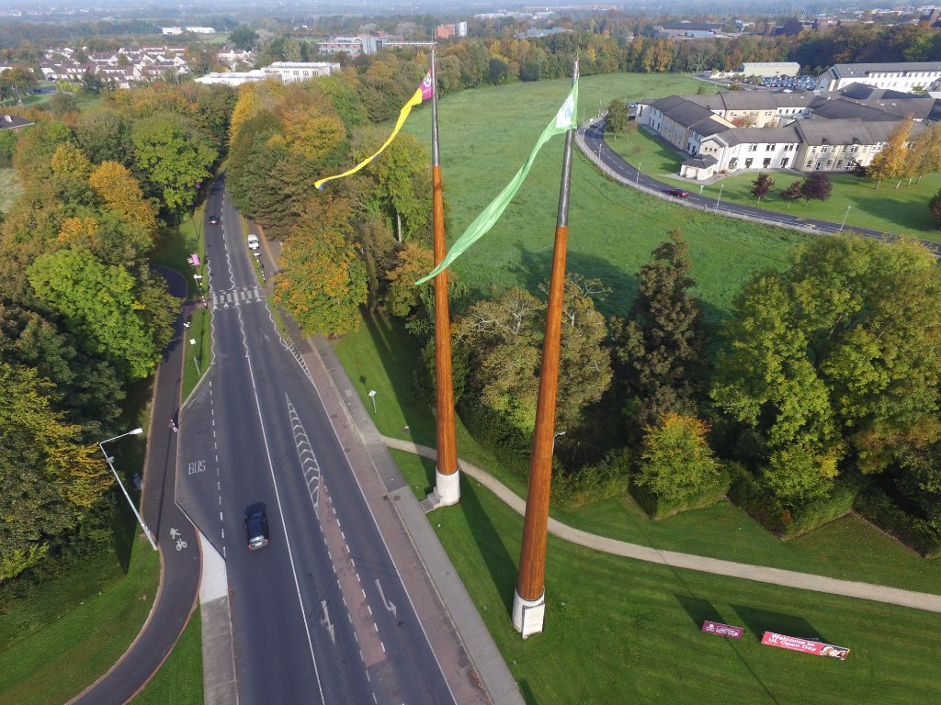
2. Assessment Instruments
20% Midterm Week 5: pen & paper exam.
40% Assignment
  Part 1: 25% OOAD + CODING
    Distributed Week 3, due week 9
  Part 2: 15% Microservices.
    Distributed Week 10, due week 12.
  Assignment is Team-Based
  1-hour Interview week 13
  An F for this project results in an F for the module
40% End of Semester Final Exam
    Project mark will not be counted if one gets an F in the exam!
Repeat: 100% Exam
( CS6451 )
© www.infoq.com

Slide 7

The Assignment
Design an implement a monolithic business tier in a 3-layered architecture app. Imperative that
  UI classes in UI package, & separate from
  Business/Service classes in business package, & separate from
  DTOs in data package
  Example of 3-Tiered Architecture
    Separation of Concerns
    Makes maintenance easier.
  No need to have a DB or GUI
    You can if you wish.
And then port to Microservices Architecture.

Slide 8
2. Module Background: Texts
Research papers.
Any text on patterns.
  Gamma et al. Design Patterns: Elements of Reusable Object-Oriented Software. Addison Wesley. 1995.
  E. Freeman and E. Robson. Head First Design Patterns:Building Extensible and Maintainable Object-Oriented Software , 2nd Edition. O’Reilly. 2020.
Any text on Refactoring
  M. Fowler. Refactoring, 2nd Ed. Addison Wesley. 2019.
Any text on general Object-Oriented Analysis and Design (OOAD) OR Object-Oriented Design.
  Bennett, S., McRobb, S., and Farmer, R. Object-Oriented Systems Analysis and Design, Fourth Edition. McGraw-Hill. 2010.
  Los more not shown here.

Slide 9
2. Schedule
CS6451 Tutorials started Week 2
Office Hours
  12:00-13:00 Wednesday
FYI
  Final Exam schedules are managed centrally by Academic Registry.
  Lecturers have no role and no say in scheduling.

Slide 10

EMAIL
You must put Course Name (MSc SE) and Module Code in the subject
Allow 36 hours for response
If you will be absent from a:
  Lecture: do NOT email me with apologies
  Tutorial: do NOT email me with apologies
Do send an email if you be absent for a contiguous block of 2 weeks or more due to illness or other personal circumstances

Slide 11
3. Module Background: Goal
To understand, critique, and apply software “design” practices.
Abstraction (INformalism)
[
Sketches
High
“Design” activities
that generate
Supporting Documentation
Textual
Descriptions
Blueprints
[
PROGRAMS: 3GL / 4GL; DSLs;
Frameworks; Libraries; etc
CODE
Assembler
Low
Executable / Machine Code

Slide 12
3. Module Background: Objectives
Describe properties of good software
Use a modelling notation – the UML, with a generic OOAD method for systems development
Discuss the concept of software architecture and its support through quality tactics.
Apply architectural and design patterns.
Execute self-guided research on Microservices and communicate critique to audience.

Slide 13
3. Factors
Component Based Development
Refactoring
OOP Overview
Knowledge
And
Skills
OOAD Using The UML
Design Patterns
Introduction to
Software Architecture
Contracts
Architectural Use Cases
Quality Tactics
Architectural Patterns

Slide 14
3. Caveat
UML usage is not very popular anymore.
Petre, Marian (2013). UML in practice. In: 35th International Conference on Software Engineering (ICSE 2013), pages 722-731.
Why → heavy commitment to UP-FRONT design.
Popularity of agile practices: SCRUM and XP.
Why study UML?
De facto standard.
Helps novices to reason explicitly about design.
Good for compute intensive applications – scientific, simulation, frameworks, tools.

Slide 15
Homework / Checklist Week 1
Read the paper “Design by Contract” by Betrand Meyers. Summarise key findings in 2 slides to present in Week 2 tutorial.
Find a paper on the UML. Read and summarise, and prepare 2 slides (max) to present in Week 2.
Read the chapter on the Observer Design Patter (DP) in Gamma et al.’s text on Design Patterns: Elements of Reusable Object-Oriented Software (1995).
Finish working through the slide deck from Week 1.
Answer the following:
    What are the characteristics of good software according to Stephens and Pooley.?
    Write coding fragments to illustrate one of the problems that can arise in an Object-Oriented runtime that does not support dynamic binding.
    Name three metrics that are used to measure quality.
    Discuss one of the contributions by David Parnas.

Slide 16
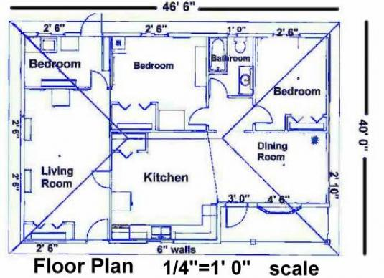
3. Example from Another Engineering Discipline
http://buildingplan.net/wp-content/uploads/2012/02/Building-Blueprints.jpg

Slide 17
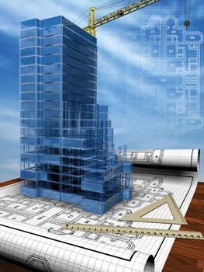
3. Example from Another Engineering Discipline
http://alphatech.sg/wp-content/uploads/2011/01/Building-with-blueprints.jpg

Slide 18
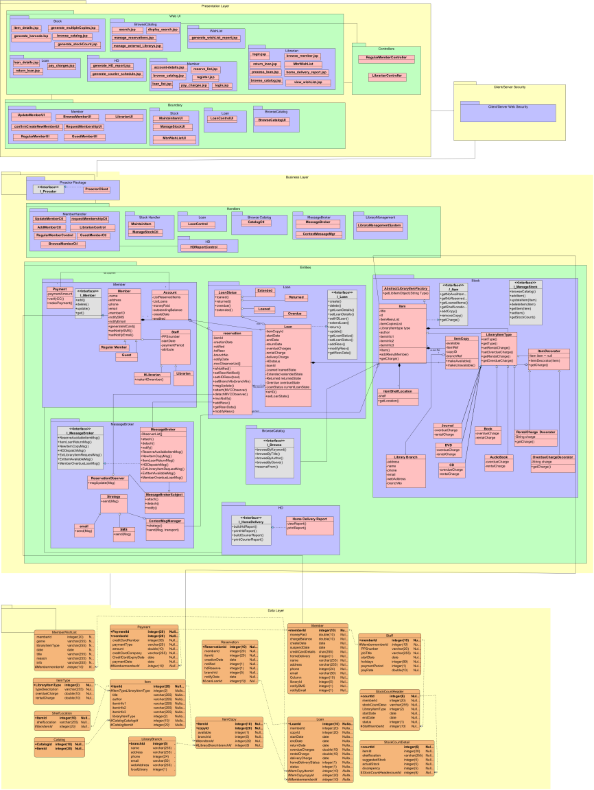
3. Example
Sample project excerpt using the Unified Modelling Language (UML) design notation.

Slide 19
3. Benefits of a Design Notation
Allows us to reason about the problem
Facilitates exploration of the solution space
Graphical-based notations have added benefit: a picture conveys a thousand words.
Supports communication amongst globally distributed multi-disciplined development teams
Helps to manage product complexity
We can stress test the design prior to construction
  Fixing bugs in the design phase is cheaper than correcting them post release
Other more mature engineering disciplines use design to move from artesian approach to factory level automated production methods
  Pre versus post industrial revolution

Slide 20
3. Liabilities of a Design Notation
What are the attributes of a good design notation?
Cost associated with learning design notation
Cost associated with producing designs
Cost associated with maintaining designs
Managers get rewarded for efficient production of code, not design.
Development approaches based on Agile Manifesto dislike UML in its entirety
  Not entirely so.

Slide 21
3. Please Remember
This module is focused on
Design principles for of software systems
And NOT solely on
A Design Notation
Such as The Unified Modelling Language (UML)

Slide 22

Next
Introducing the lecturer
Introduce assessment model and texts
Discuss objectives and rationale
Characteristics of Good Software
The OO Paradigm

Slide 23
4. Good Software is ......
Good systems should be usable, reliable (bug free), affordable, flexible, and available.
  These are quality attributes that are not specific to software.
Maintenance consumes 50-70% of budgetary resources in software lifecycle
50% of costs of maintenance associated with comprehension
  Diagram support might reduce cost of comprehension!

Slide 24
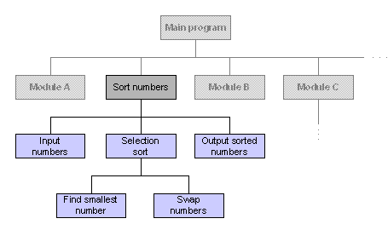
4. Good Software: Modules
Figure. An example of modular decomposition for the …. Lotto.;
(https://courses.cs.vt.edu/~csonline/SE/Lessons/Procedural/index.html)
Good Systems Consist of Modules
David Parnas advocated modular decomposition as far back as the early 1970s.
A system is a collection of modules: files, subroutines, library functions, classes in an object oriented language, other constructs known as module or similar, independent or semi-independent programs or subsystems.
  What characteristics can be used to guide the decomposition process?
  Metrics: can these characteristics be measured?
  See MQ – Modularisation Quantity

Slide 25
4. Good Software: Dependency
Good modules: must consider dependency, coupling, cohesion, interface, encapsulation and abstraction.
Good Systems Have Minimal Dependency/Coupling
Module A depends on Module B if it possible for some change to Module B to require modifications to Module A. Module A is a client of Module B, or that Module B acts as a server to Module A.
Circular dependency: two modules are both clients and servers to each other. To be avoided.
Good systems have low coupling, and thus, changes in one part of the system do not propagate throughout the rest of the system.
Must identify which modules are coupled.
Two types of facts that may be useful:
  Which modules are clients of a given module?
  What assumptions may clients of a given module make about it?

Slide 26
4. Good Software: Interfaces
interface IDraw {
void draw();
}
class Rectangle implements IDraw {
  void draw() {
  // some implementation
  }
  // implementation of other methods;
}
In the main() method
      // the type of shape is IDraw and NOT Rectangle!
IDraw shape = new Rectangle();
shape.draw();
    // the following will generate a compile time error
shape.colour();
The interface defines a contract.
It is a listing of methods that (a) must be provided by the service provider, and (b) used by the client.
Obligations and assumptions
No implementation is provided for any of the methods in the interface.
The service provider (server) is Rectangle, and it provides the implementation.
The client is the main() method.

Slide 27
Good Software: Interfaces
Good Systems Have Interfaces
An interface to a module – class in this example, defines some features of the module on which its clients may rely.
Car Sharing System – 2 development views/perspectives
  Enquirers
  Car Sharers
2 interfaces
  interface IEnquirer {
    int enquire(Coord start; Coord end);
  }
  interface ICarSharer {
    int carShare(Coord start; Coord end; IEnquirer enquirer);
  }

Slide 28
Good Software: Interfaces
class Person implements IEnquirer, ICarSharer {
  int enquire(Coord start; Coord end) {
  // some implementation
  }
  int carShare(Coord start; Coord end; IEnquirer enquirer){
    // some implementation;
  }
  // implementation of other methods
}
In the main() method
  IEnquirer e = new Person();
      // the type of e is IEnquirer and NOT Person!
  e.enquire(…..);
  e.carShare(….) // will generate a compile time error
  // some time later
  ICarSharer cs = (CarSharer)(e);
  cs.carShare(….);

Slide 29
Good Software: Interfaces
Good Systems Have Interfaces
An interface to a module defines some features of the module on which its clients may rely.
“The connection between modules are the assumptions which the modules make about each other”
  Software Fundamentals. Collected Papers by David L. Parnas. Ed. By Daniel. M. Hoffman and David M. Weiss. Addison-Wesley. 2001.
Document such assumptions in interfaces and check their correctness.
Should be automatic checks to ensure that no client makes any assumptions about its server that is not documented in the interface.

Slide 30
Interfaces
Retail banking example:
Jim has a balance of 100 in his Current Account No. 176588932.
 | Signature / Call | Syntactically Correct | Semantically Correct
Server | + debit (amount: integer, accountNo: integer): integer
Client 1 call | debit(100,176588932) | YES | YES
Client 2 call | debit(100.00, 176588932) | NO | YES
Client 3 call | debit(176588932,100) | YES | NO
Note:
Compilers enforce syntactic checks.
Cannot enforce semantic compliance.

Slide 31
4. Good Software: Context Dependencies
The services a module requires are called its context dependencies. May be expressed in terms of an interface.
  i.e. Libraries, operating system, etc.
The module's own interface(s) and its context dependencies constitute a contract describing the module's responsibilities.
If a module changes internally without changing its interface, this change will not impact other modules that depend on it.

Slide 32
4. Interfaces
Specification of a contract between a service (software) and a client (software) that uses the service API.
Contracts must be enforceable
Syntactic: signature, parameters, return type, etc., match.
Semantic: the meaning of the arguments supplied in the client call correlates with the intent of the parameters in the method heading.
Not currently doable.

Slide 33
Interfaces.
Operations in interfaces can have pre and post conditions
Example: operation debit(account no, amount) on class Account
  Pre:
    Account.balance – amount > Account.overdraftLimit;
  Post:
    Account.balance has been decremented by amount;
    Transaction has been persisted;
    Transaction has been logged;
Conceptually similar to the fine print in a contract

Slide 34
Interfaces.
If pre-condition is not satisfied, no obligation on service provider – object(s), to support a valid engagement
Otherwise, service provider guarantees that the state of the salient parts of the system will be as specified in post condition
Pre conditions can help eliminate defensive programming when writing a method
  Who is responsible for ensuring that pre-condition is satisfied?
See Betrand Meyer’s 1992 paper “Design by Contract” which popularised the concept of pre and post conditions.
  http://se.ethz.ch/~meyer/publications/computer/contract.pdf
Led to development of Eiffel, a constraint-based OO language.
  As opposed to a type-based OO language.

Slide 35
4. Good Software: Benefits of Modularity with Defined Interfaces
Easier to maintain.
Easier to upgrade a modular system.
Easier to build a system that is reliable because modules can be tested more thoroughly in isolation.
Modules can be coded and tested concurrently, thus speeding up time-to-market.
Team members only need to know other module interfaces, not how they works.
Can reuse modules because of the property of documented interface(s).

Slide 36
4. Good Software
Cohesion, Abstraction, Encapsulation, and Information Hiding.
Good modules have the property that their interfaces provide an abstraction of some intuitively understood concept.
Such modules are said to have high cohesion.
Abstraction is when a client of a module does not need to know more than is documented in the interface.
Encapsulation is when a client is not allowed to know more than is in the interface.
Information hiding - encapsulation and abstraction

Slide 37
4. Good Software
A good system consists of encapsulated modules with high cohesion and managed dependencies that are at the correct level of abstraction. The services provided by the system are clearly specified through interfaces.
(Stevens and Pooley, 2000).

Slide 38
4. Good Software: CBD
Serves as a basis for Component Based Development (CBD)
A module may have several interfaces
If a module is a good abstraction - high cohesion and low coupling - may be able to reuse it or replace it.
Pluggable component.
Also depends on the architecture in which the component is developed.
Architecture-centric CBD.

Slide 39
Next
Introducing the lecturer
Introduce assessment model and texts
Discuss objectives and rationale
Characteristics of Good Software
Essentials of the OO Paradigm

Slide 40
5. Key Features of the OO Paradigm
Classes and Objects
Generalisation
  Programmers refer to this as inheritance
Polymorphism
Templates

Slide 41
5. Classes and Objects
An object has state, behaviour and identity (Booch, 1994).
Objects are sometimes deliberately characterised as if each is a person with roles (Wrifs-Brock et al., 1990):
  Who am I?
  What can I do?
  What do I know?
An object represents a particular instance of a class (Rational, 1997).
Classes are intended to be loosely coupled, highly cohesive modules.

Slide 42
5. Methods and Messages
Object oriented: locate each process with the data it uses.
Processes are called operations or methods.
Each method has a specific signature - also known as message protocol or method declaration.
An operations signature = operation’s interface.
The definition supplies an implementation that supports the operation specified in the declaration.

Slide 43
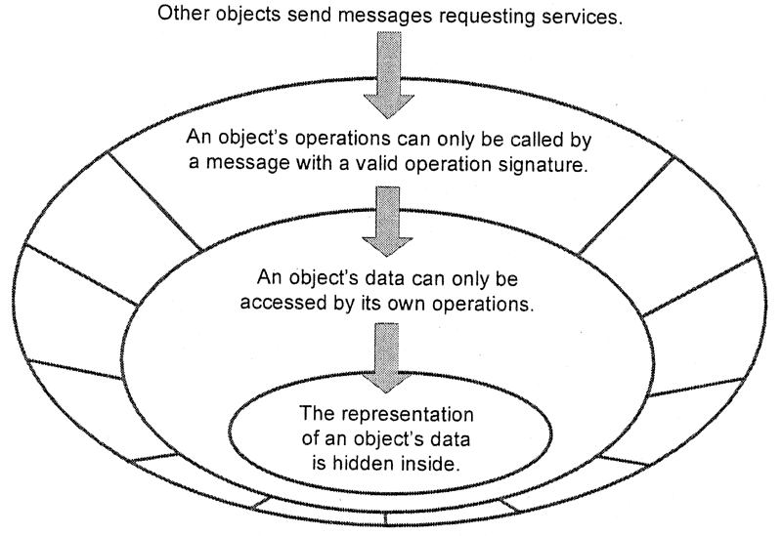
5. Methods and Messages Supporting Encapsulation

Slide 44
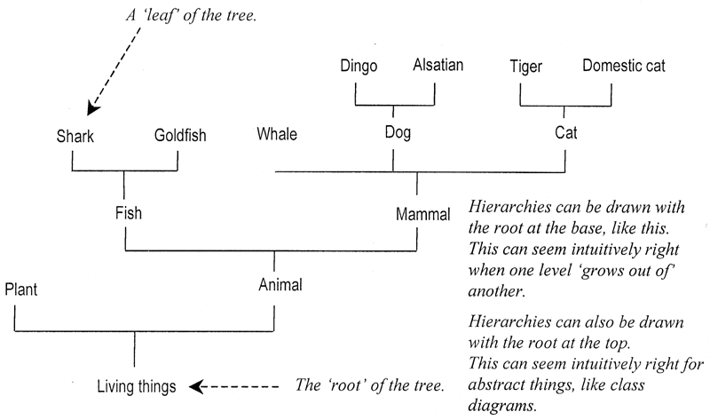
5. Generalisation

Slide 45
5. Generalisation
Generalisation: taxonomic relationship between a more general element and a more specific element that is fully consistent with the first element and that adds additional information - UML Semantics Guide (Rational, 1997).
Taxonomic: a hierarchy of relationships.
Object classes can be arranged into hierarchies.
Known as Inheritance in OO languages
superclass and subclass.

Slide 46
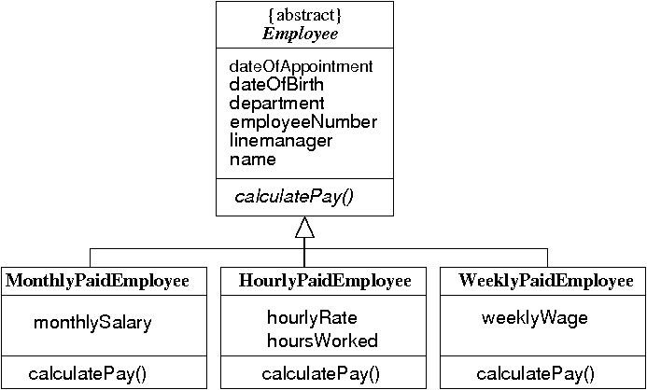
5. Generalisation
Superclass in this example happens to be an abstract class.
Terminology: subclass, derived from, specialization / superclass, base class.

Slide 47
5. Polymorphism: Example 1
interface IDraw {
public void draw();
}
class Circle implements IDraw {
public void draw() {
System.out.println("drawing a circle");
}
}
class Square implements IDraw {
public void draw() {
System.out.println("drawing a square");
}
}

Slide 48
5. Polymorphism: Example 1
public class Polymorphism1 {
public static void main(String[] args) {
List<IDraw> myList = new ArrayList<IDraw>();
myList.add(new Circle());
myList.add(new Square());
// polymorphism in action
for (IDraw item : myList) {
item.draw();
}
}
}

Slide 49
5. Polymorphism: Example 2
abstract class Shape {
abstract public void draw(); // can only draw concrete shapes
void someOthermethod() { System.out.println(" hello ");}
}
class Square extends Shape {
public void draw() {
System.out.println("drawing a square");
}
}
class Circle extends Shape {
public void draw() {
System.out.println("drawing a circle");
}
}

Slide 50
5. Polymorphism: Example 2
public class Polymorphism2 {
public static void main(String[] args) {
Shape[] myShapes = {new Square(), new Circle()};
// yet another example of polymorphism in action
for (Shape item : myShapes) {
item.draw();
}
}
}

Slide 51
5. Without Polymorphism: Example 3
class Circle {
public static void draw() {
System.out.println("drawing a circle " + name);
}
}
class Square {
public static void draw() {
System.out.println("drawing a square " + name);
}
}

Slide 52
5. Without Polymorphism: Example 3
public class LacksPolymorphism3 {
public static void main(String[] args) {
List list = new ArrayList();
list.add(new Circle());
list.add(new Square());
for(Object obj : list) {
if (obj instanceof Circle) {
Circle.draw();
}
else if (obj instanceof Square) {
Square.draw();
}
else {
// error condition
}
}

Slide 53
5. Without Polymorphism: Example 3
Previous code: adding a new concrete shape, for example, a triangle, to the server side (classes Square and Circle); will necessitate significant change to the core business logic in the client.
  Client – class LacksPolymorphism3
  Core business logic: if statement
Previous code: if statements increase McCabe Cyclomatic Complexity measure
  Measure of number of different flows through code
  Should try to minimise this metric
  Presence of if statements increase cost of testing and evolution support.
Inserting the following would generate a compile time error in the previous code: "the method draw is undefined for the type of Object"
for(Object obj : list){
obj.draw();
}

Slide 54
5. Without Polymorphism: Example 4
public class LacksPolymorphism4 {
public static void main(String[] args) {
ArrayList<Circle> circleList = new ArrayList<Circle>();
ArrayList<Square> squareList = new ArrayList<Square>();
circleList.add(new Circle());
squareList.add(new Square());
for(Circle item : circleList) {
item.draw();
}
for(Square item : squareList) {
item.draw();
}
}
}

Slide 55
5. Without Polymorphism: Example 2
Previous code: duplication of core business logic – the for loop.
Duplication of business logic to be avoided. Why?
  Change to business rules requires change to business logic.
  Danger of not implementing change in ore or more duplicates
  Bug
Studies show that up to 30% of codebases consists of duplicates of varying degrees!

Slide 56
5. Polymorphism
Polymorphism: “one interface, multiple methods”.
In OO languages, polymorphism supported at compile time and run time.
Compile time: function and operator overloading.
Runtime polymorphism: known as overriding, late binding or dynamic binding.
Same message being passed to different objects, with objects responding in a different way.

Slide 57
5. Benefits of Polymorphism
See example classes Polymorphism1 and Polymorphism2
Implementation requires supertypes: interfaces or superclasses
Benefit: impact on client code minimised by changes to server side implementation
  Client code in previous examples: class with main method
  Server side: classes Circle, Square, and supertype.
  Change: adding a new concrete shape to the server side i.e. a Triangle
→ Supports extensibility → Evolution support

Slide 58
5. Polymorphism → SUPPORTING EVOLUTION
We have seen
List of employees
  where each element is instantiated from a different subclass in the inheritance hierarchy
List of shapes and drawables
  Where each element is instantiated from a subclass in the inheritance hierarchy, or a class that implements the interface
Talked about a list of students
  where each element in the list is instantiated from:
    different subclasses in the student taxonomic hierarchy AND/OR
    Classes that implement an explicit student interface
  i.e. EUundergraduate, nonEUundergraduate, EUlinkIn, nonEUlinkIn
→ all subject to constant change

Slide 59
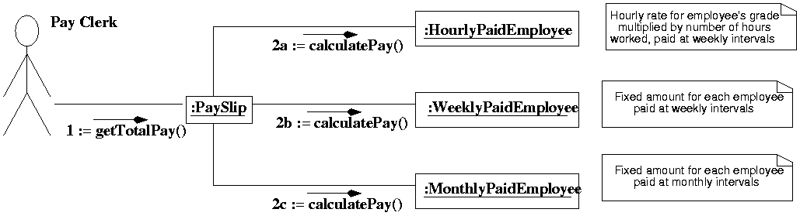
5. Polymorphism in Diagrammatic Form
Illustrated using a Communication diagram

Slide 60
5. Polymorphism
Runtime polymorphism dependent on dynamic (late) binding.
Dynamic (late) binding: determining which code to execute at run time.
C++:
  Use the keyword virtual
  A virtual function is a function that is declared as virtual in a base class and redefined in one or more derived classes.
  Virtual functions are special because when one is accessed using a pointer of the base class to an object of a derived class, C++ determines which function to call at run-time, based on the type of object pointed to.

Slide 61
5. Polymorphism
Italics imply that the element is abstract

Slide 62
5. Comparison of Sample OO Languages
Feature | Java | C++ | C# | PhP | Perl | Python | Ruby | VB.Net
Strong typing | ✓ | Opt. | ✓ | X | X | ✓ | ✓ | ✓
Static or Dynamic typing | S | S | Both | D | Both | D | D | S
Garbage collection | ✓ | X | ✓ | X | X | ✓ | ✓ | ✓
Multiple inheritance | X | ✓ | X | X | ✓ | ✓ | X | X
Pure objects | X | X | X | X | X | X | ✓ | X
Dynamic loading | ✓ | X | ✓ | ✓ | ✓ | ✓ | ✓ | ✓
Standardised class libraries | ✓ | X | X | ✓ | ✓ | ✓ | ✓ | ✓
Adapted from Simon Bennett, Steve McRobb, and Ray Farmer.
Object-Oriented Systems Analysis and Design, 4th Edition. McGraw Hill, 2010,
Figure 4.9 page 109

Slide 63
3. Origins of the OO Paradigm
Early work on computer simulation - event driven programming, very difficult for 3GLs. Led to development of Simula.
Structure program as a set of independent software agents, each agent represents an agent in the real world.
  The application domain and software are better aligned using the concept of agents (objects)
Spread of GUIs: difficult to design or control in a procedural way.

Slide 64
Homework
Read the paper “Design by Contract” by Betrand Meyers. Summarise key findings in 2 slides to present in Week 2 tutorial.
Scan the chapter from Martin Fowler on Refactoring.
Finish working through the slide deck from Week 1.
Answer the following:
    What are the characteristics of good software according to Stephens and Pooley.?
    Write coding fragments to illustrate one of the problems that can arise in an Object-Oriented runtime that does not support dynamic binding.
    Name three metrics that are used to measure quality.
    Discuss one of the contributions by David Parnas.
    Reasons for a standard notation such as The Unified Modelling Language (UML).

Slide 65
Reading that augments slide deck
Bennett, McRobb, and Farmer: chapters 3 and 4
OR
Stevens and Pooley: chapters 2 and 4.

